Slide 1
Dynamic Programming
Prof. Tae-Hyoung Park
Dept. of Intelligent Systems & Robotics, CBNU

Slide 2



State-Value Function
Bellman Equation
Definition
Bellman equation
Bellman equation – iterative (update) form
다음 상태의 가치함수 $v_{π}(s′)$ 와 현재 상태 의 가치함수 $v_{π}(s)$ 의 관계식
연립 방정식 문제 => 복잡한 문제에 적용 어려움
$V_{k}(s)$: $k$ 번째로 갱신(update) 된 가치함수의 ‘추정치’
추정치 $V_{k}(s′)$ 로 부터 또 다른 추정치 $V_{k+1}(s)$ 를 갱신 (update)
$V_{0}\left(s\right)$ → $V_{1}\left(s\right)$→ … → $V_{k}\left(s\right)$→ $V_{k+1}\left(s\right)$→ …
Iterative form ⇒ 반복문을 사용한 computer program 으로 해를 구할 수 있음
dynamic programming

Slide 3
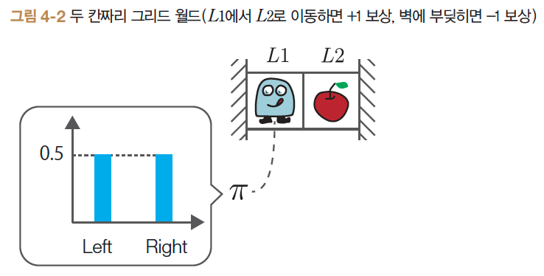


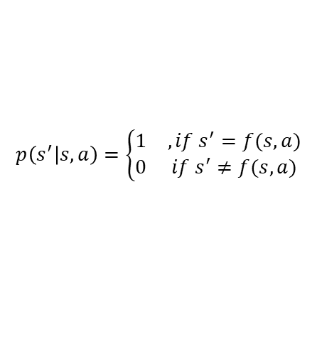
State-Value Function
2-Grid World
Iterative Bellman equation
→
→
$$p\left(s^{′} | s,a\right)=\left\{\begin{matrix}1 & , if s^{′}=f(s,a) \\ 0 & if s^{′}≠f(s,a)\end{matrix}\right.$$
For the deterministic state-transition

Slide 4
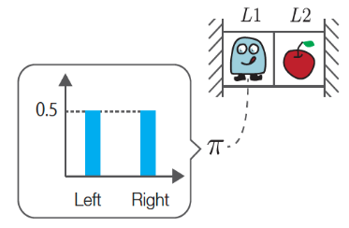
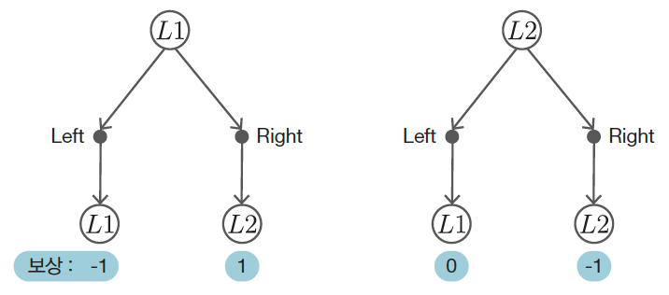

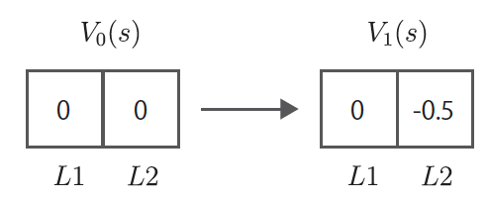
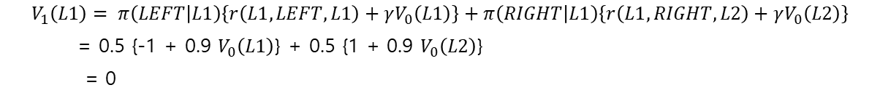

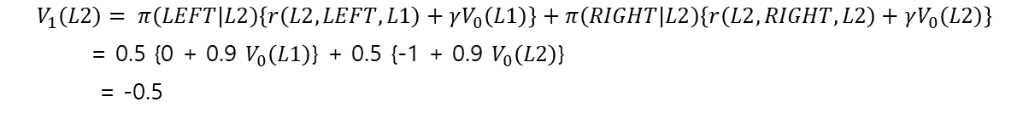
State-Value Function
2-Grid World
$V_{0}\left(s\right)$
$V_{1}(s)$
$$V_{1}\left(L1\right)= π\left(LEFT | L1\right)\left\{r\left(L1,LEFT,L1\right)+γV_{0}\left(L1\right)\right\}+π\left(RIGHT | L1\right)\left\{r\left(L1,RIGHT,L2\right)+γV_{0}\left(L2\right)\right\}$$
= 0.5 {-1 + 0.9 $V_{0}\left(L1\right)$} + 0.5 {1 + 0.9 $V_{0}\left(L2\right)$}
= 0
$$V_{1}\left(L2\right)= π\left(LEFT | L2\right)\left\{r\left(L2,LEFT,L1\right)+γV_{0}\left(L1\right)\right\}+π\left(RIGHT | L2\right)\left\{r\left(L2,RIGHT,L2\right)+γV_{0}\left(L2\right)\right\}$$
= 0.5 {0 + 0.9 $V_{0}\left(L1\right)$} + 0.5 {-1 + 0.9 $V_{0}\left(L2\right)$}
= -0.5

Slide 5
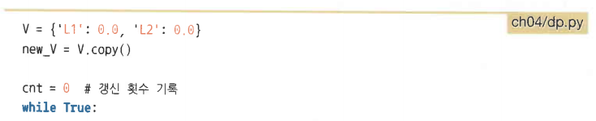
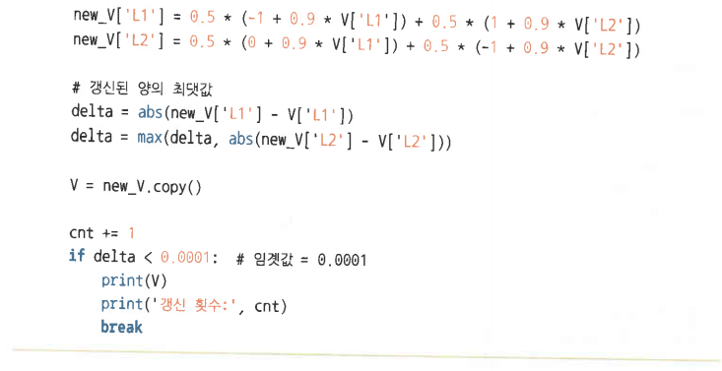
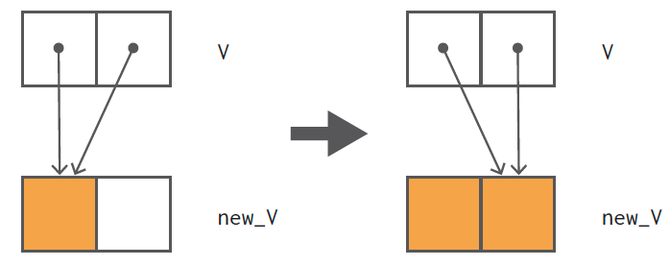


State-Value Function
2-Grid World
Program
결과
Dictionary data structure
$$V_{76}\left(L1\right)=−2.249$$
$$V_{76}\left(L2\right)=−2.749$$

Slide 6
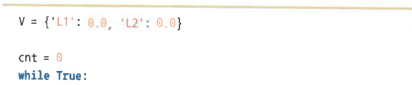
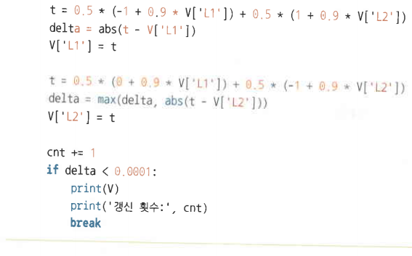
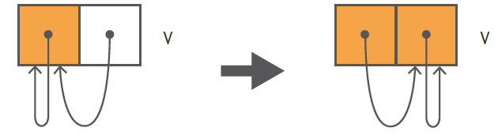


State-Value Function
2-Grid World
Program : In-place method
결과
$$V_{60}\left(L1\right)=−2.249$$
$$V_{60}\left(L2\right)=−2.749$$

Slide 7
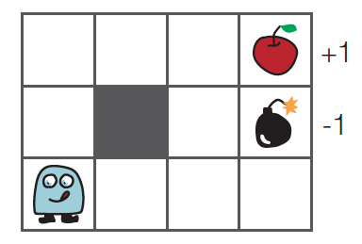
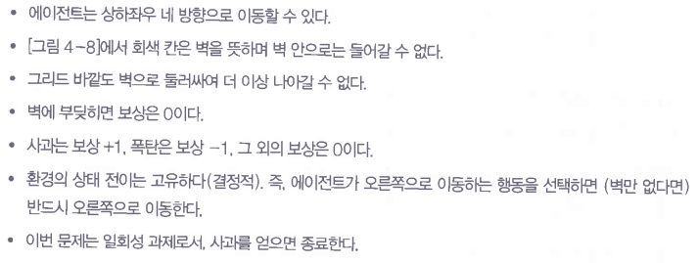
State-Value Function
3 x 4 Grid World

Slide 8
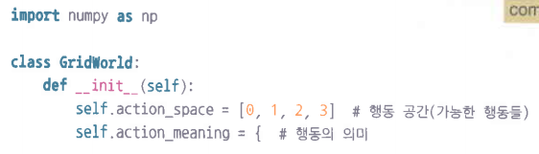
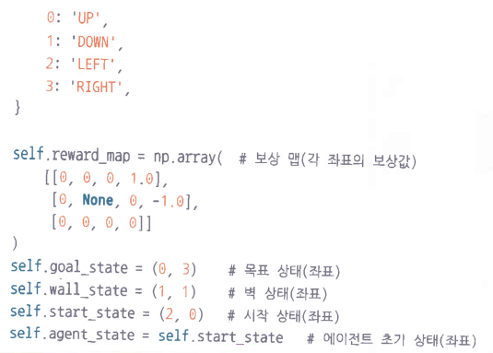
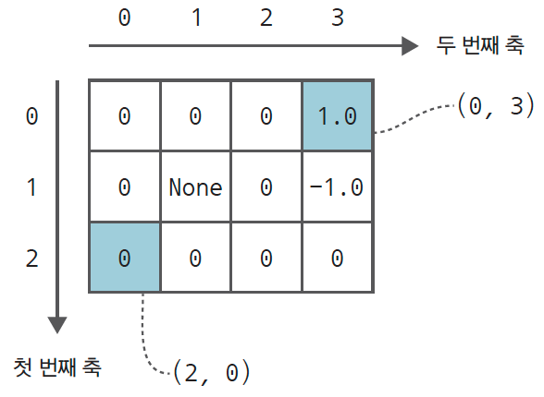
State-Value Function
GridWorld Class
initialization

Slide 9
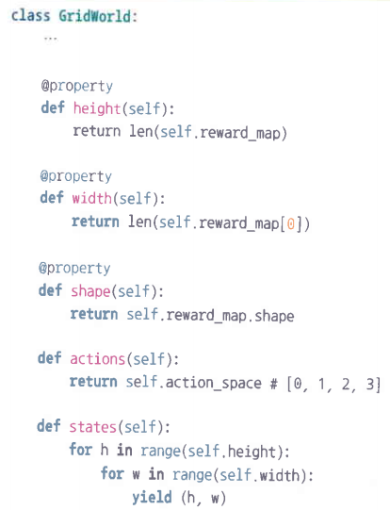
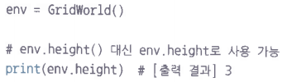

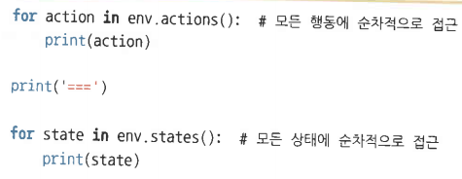

State-Value Function
GridWorld Class
method

Slide 10
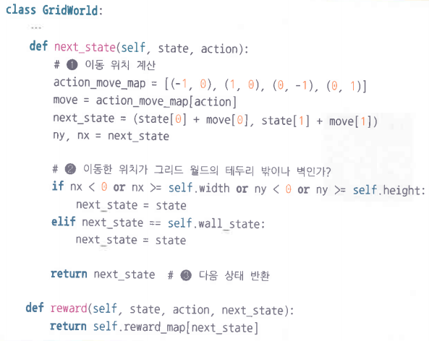


State-Value Function
GridWorld Class
$$s^{′}=f(s,a)$$
$$r(s,a,s′)$$

Slide 11
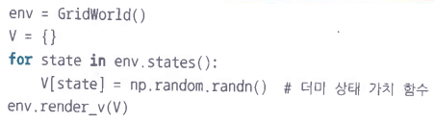
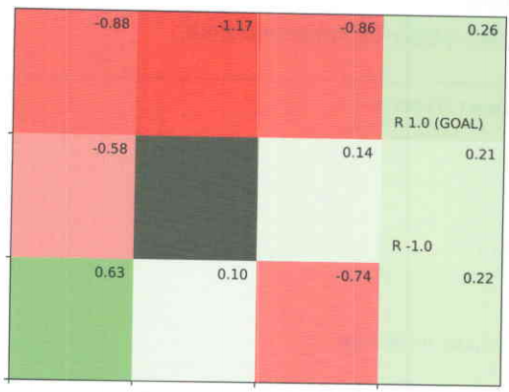
State-Value Function
GridWorld Class
시각화 함수: render_v()

Slide 12
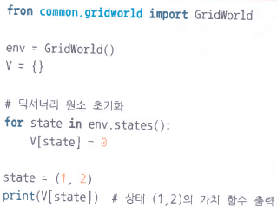
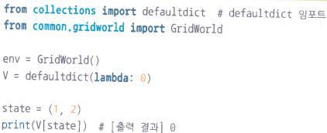



State-Value Function
defaultdict
파이썬에서 제공하는 dictionary 자료구조
자동 초기화 기능
$$V_{k}(s)$$
$$π(a|s)$$

Slide 13
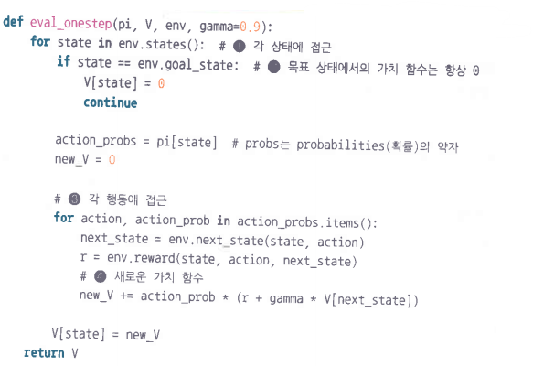
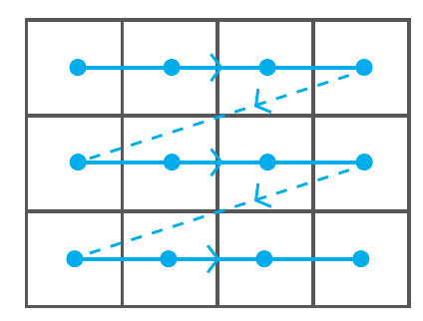

State-Value Function
One-Step Evaluation
$$a :π(a|s)$$

Slide 14
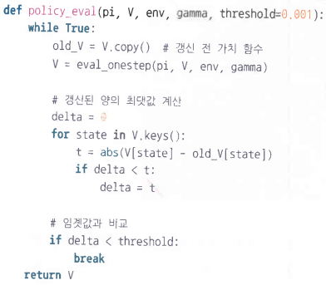



State-Value Function
Iterative Evaluation
$V_{k}(s)$ 값이 수렴할 때 까지 one-step evaluation 을 반복
$$k=1,2,⋯,$$
$$v_{∗}(s)$$

Slide 15

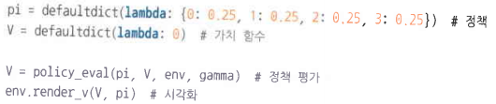
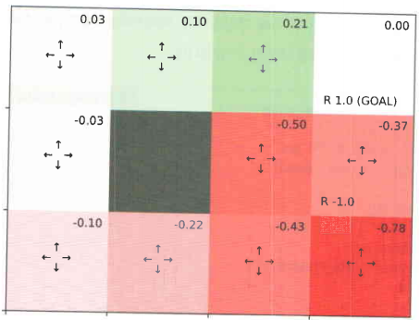


State-Value Function
Iterative Policy Evaluation
주어진 policy $π\left(a | s\right)$ 에 대한 state value $v_{π}\left(s\right)$를 계산
$$k=1,2,⋯,$$

Slide 16
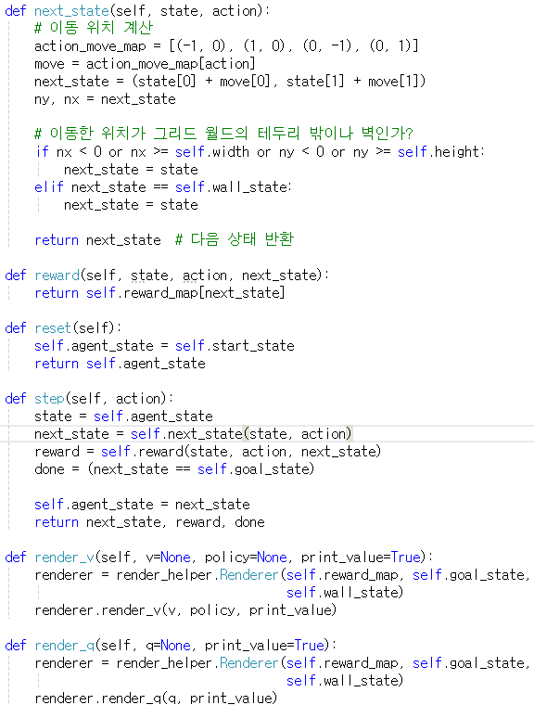
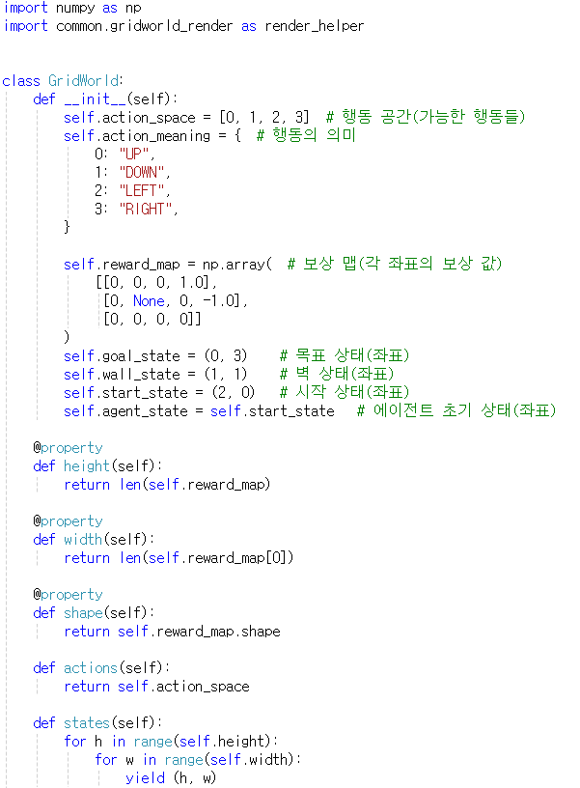
Iterative Policy Evaluation
실습 #1
gridworld.py

Slide 17
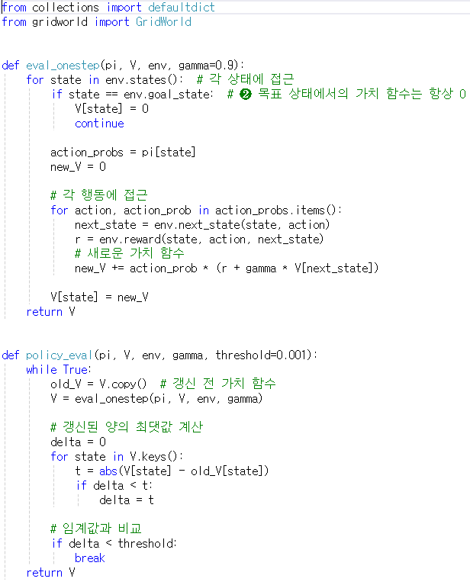
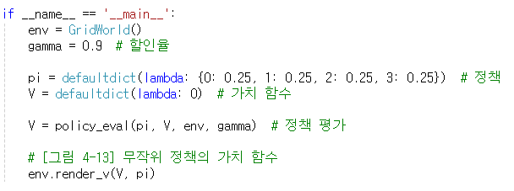
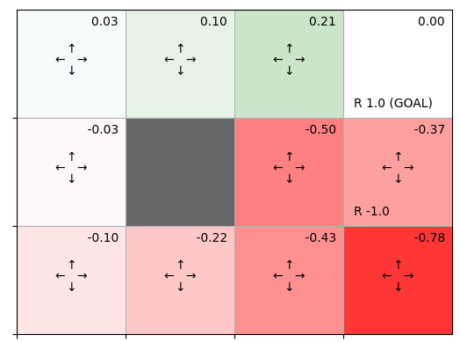
Iterative Policy Evaluation
실습 #1
policy_eval.py

Slide 18
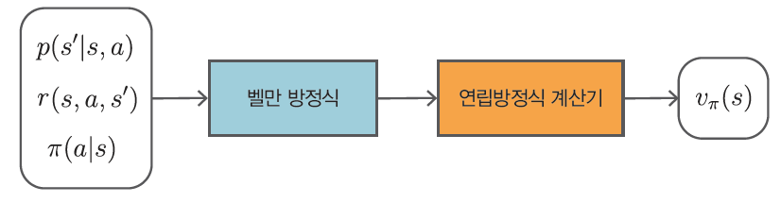
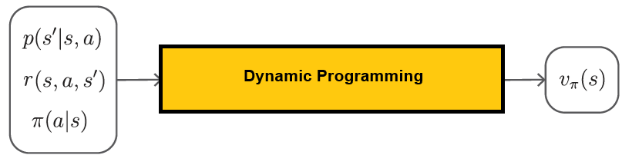
Iterative Policy Evaluation
요약

Slide 19
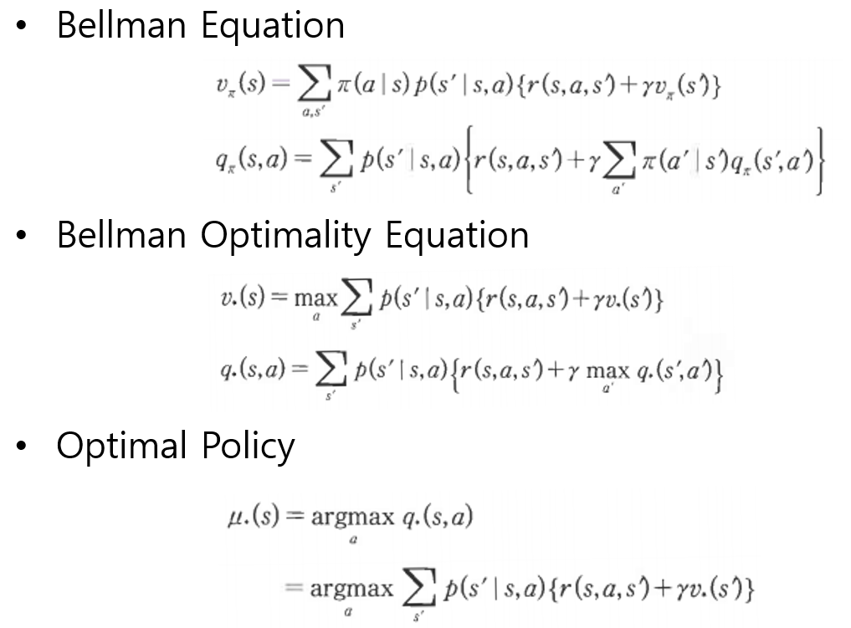

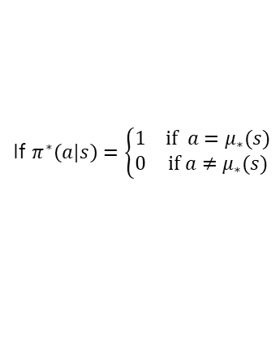


Optimal Policy
Bellman Equation
State-value & action value:
State-value & action value of optimal policy: $v_{∗}(s)$, $q_{∗}(s)$
Optimal policy: $μ_{∗}(s)$
$$v_{π}\left(s\right), q_{π}(s,a)$$
If $π^{∗}\left(a|s\right)=\left\{\begin{matrix}1 & \text{if} a=μ_{∗}(s) \\ 0 & \text{if} a≠μ_{∗}(s)\end{matrix}\right.$
현재의 action 후보 중에서 최선의
action 을 선택 ⇒ Greedy policy

Slide 20
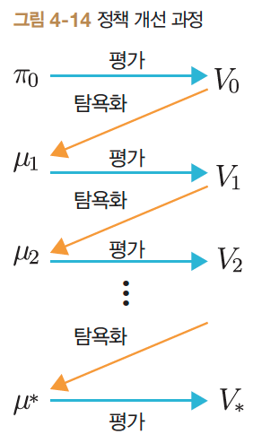
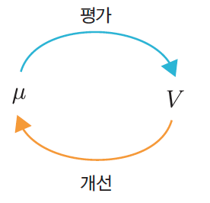
Policy Iteration Method
Policy Iteration (정책 반복법)
Optimal policy 를 구하기 위한 방법
Policy improvement procedure
Evaluation & Update
Evaluation: Iterative policy evaluation
Update : greedy selection

Slide 21
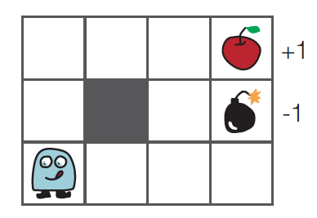

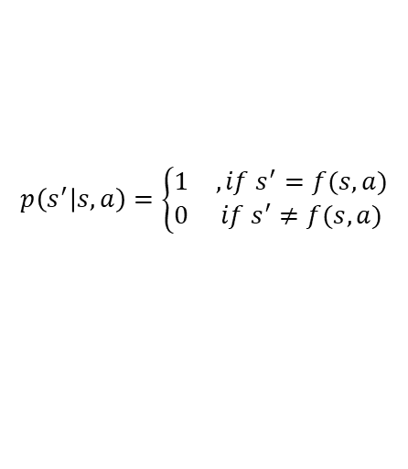
Policy Iteration
3 x 4 Grid World
For the deterministic state-transition
$$p\left(s^{′} | s,a\right)=\left\{\begin{matrix}1 & , if s^{′}=f(s,a) \\ 0 & if s^{′}≠f(s,a)\end{matrix}\right.$$

Slide 22
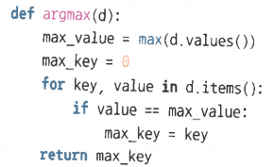
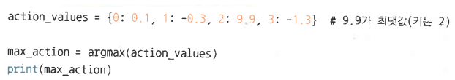

Policy Iteration Method
argmax()

Slide 23



Policy Iteration Method
greedy_policy()
$$μ_{∗}\left(s\right)=\arg{\max_{a}{\{r\left(s,a,s^{′}\right)+γv_{π}(s)}\}}$$
$$π^{∗}(a|s)$$

Slide 24




Policy Iteration Method
policy_iter()
$$v_{∗}\left(s\right)=\sum_{a}{π\left(a | s\right)\{r\left(s,a,s^{′}\right)+γv_{∗}\left(s\right)\}}$$
$$μ_{∗}\left(s\right)=\arg{\max_{a}{\{r\left(s,a,s^{′}\right)+γv_{∗}\left(s\right)\}}}$$
$$π^{∗}(a|s)$$

Slide 25



Policy Iteration Method
$μ_{∗}(s)$ & $v_{∗}(s)$

Slide 26


Policy Iteration Method
실습 #2
policy_iter.py

Slide 27




Policy Iteration Method
실습 #2

Slide 28




Value Iteration Method
Policy Iteration Method
def policy_iter(env, gamma, threshold=0.001):
pi = defaultdict(lambda: {0: 0.25, 1: 0.25, 2: 0.25, 3: 0.25})
V = defaultdict(lambda: 0)
while True:
V = policy_eval(pi, V, env, gamma, threshold) # 평가
new_pi = greedy_policy(V, env, gamma) # 개선
if new_pi == pi: # 갱신 여부 확인
break
pi = new_pi
return pi
$$v_{∗}\left(s\right)=\sum_{a}{π\left(a | s\right)\{r\left(s,a,s^{′}\right)+γv_{∗}\left(s\right)\}}$$
$$μ_{∗}\left(s\right)=\arg{\max_{a}{\{r\left(s,a,s^{′}\right)+γv_{∗}\left(s\right)\}}}$$
$$π^{∗}(a|s)$$

Slide 29








Value Iteration Method
Evaluation & Update Equation
Update (개선)
Evaluation (평가) #1
Evaluation (평가) #2
$s^{′}=f\left(s,a\right)$ 일 때
(deterministic case)
$$μ\left(s\right)=\arg{\max_{a}{\{r\left(s,a,s^{′}\right)+γV\left(s^{′}\right)\}}}$$
$s^{′}=f\left(s,a\right)$ 일 때
(deterministic case)
$$V^{′}\left(s\right)=\sum_{a}{π\left(a | s\right)\{r\left(s,a,s^{′}\right)+γV\left(s^{′}\right)\}}$$
계산 시 policy $π\left(a | s\right)$ or $μ(s)$ 필요
Policy Iteration method
계산 시 policy $π\left(a | s\right)$ or $μ(s)$ 불필요
Value Iteration method

Slide 30






Value Iteration Method
value_iter_onestep()
$$s^{′}=f(s,a))$$
$$r\left(s,a,s^{′}\right)+γV′(s^{′})$$
$$\max{\{r\left(s,a,s^{′}\right)+γV^{′}\left(s^{′}\right)\}}$$

Slide 31



Value Iteration Method
value_iter()
$$V_{k}^{′}(s)$$
$$k=1,2,⋯,$$

Slide 32



Value Iteration Method
Optimal policy

Slide 33

Policy Iteration vs. Value Iteration
Policy Iteration Method
Value Iteration Method
pi = defaultdict(lambda: {0: 0.25, 1: 0.25, 2: 0.25, 3: 0.25})
V = defaultdict(lambda: 0)
while True:
V = policy_eval(pi, V, env, gamma, threshold) # 평가
new_pi = greedy_policy(V, env, gamma) # 개선
if new_pi == pi: # 갱신 여부 확인
break
pi = new_pi
return pi
V = defaultdict(lambda: 0)
env = GridWorld()
gamma = 0.9
V = value_iter(V, env, gamma) # 최적가치함수
pi = greedy_policy(V, env, gamma) # 최적정책
env.render_v(V, pi)

Slide 34

Policy Iteration vs. Value Iteration
Policy Iteration Method
Value Iteration Method

Slide 35


Value Iteration Method
실습 #3
value_iter.py

Slide 36





Value Iteration Method
실습 #3

Slide 37



Quiz
(Q) Dynamic programming 을 적용하여 5x5 Grid World 에 대한 value function 및 policy 를 구하라.
Policy iteration method
Value iteration method
-1
+1
-1

